Slide 1

ACS Installation and SDK Configuration

Slide 2
Table of Contents
Alfresco Installation Maven Overview Development Environment setup Alfresco SDK 3.0 Overview and Configuration Create projects using Alfresco archetypes Packaging modules References

Slide 3
Alfresco Installation
Depending on your system, you can install Alfresco using one of the following methods:
Using a setup wizard, which contains the required software and components you need for evaluating Alfresco
Using a standard WAR file to deploy Alfresco in a production environment
3

Slide 4
Installing software required for Alfresco
Component | Recommendation
Java SE Development Kit (JDK) | The Oracle Java JDK 8 or higher version is required. The JAVA_HOME environment variable must be set to the location of the JDK installation.
Application server | Alfresco runs within an application server. Alfresco Enterprise runs within Tomcat but can be installed on other application servers like WebLogic or JBoss.
Database | Alfresco comes preconfigured with the PostgreSQL database. If you intend to use Alfresco in a production environment, you can use one of the supported databases like My Sql, Oracle, Microsoft SQL Server or DB2.
LibreOffice | Alfresco uses LibreOffice for transforming documents from one format to another, for example, a text file to a PDF file.
ImageMagick | Alfresco uses ImageMagick to manipulate images for previewing.
4

Slide 5
Installing software required for Alfresco
Component | Recommendation
GhostScript | Alfresco uses GhostScript in conjunction with ImageMagick to manipulate images for previewing.
Flash Player | Alfresco Share requires Flash Player Version 10.x to upload multiple files and view Flash previews. If you do not install Flash, you see the upload screen for single files. Use the latest (stable) version of Flash Player for your platform.
SWF Tools | Alfresco Share uses the pdf2swf utility for previewing PDF files. If you do not install SWF Tools, you will not see PDF previews, but image previews will still be available.
5

Slide 6
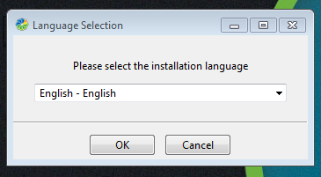
Alfresco Installation Steps
Using the Alfresco Content Service installer, we can install Alfresco. (lfresco-content-services-installer-5.2.1-win-x64.exe for 64 bit).
6

Slide 7
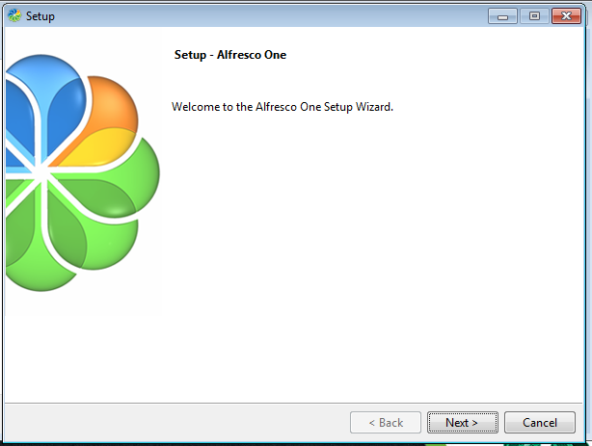
Alfresco Installation Steps
7

Slide 8
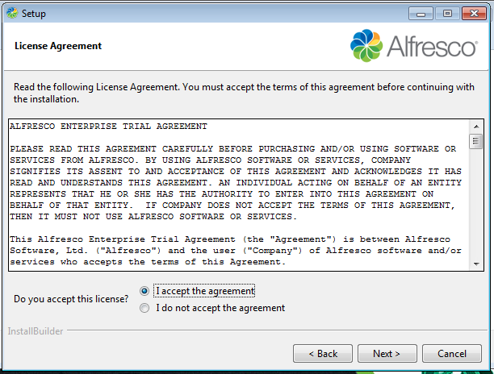
Alfresco Installation Steps
8

Slide 9
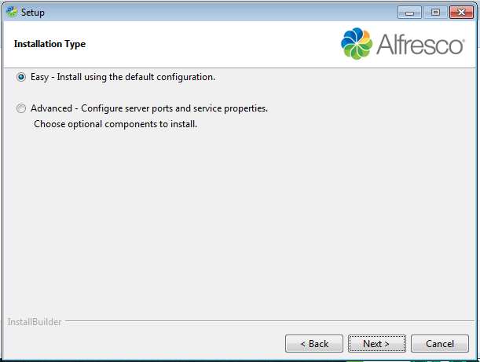
Alfresco Installation Steps
9

Slide 10
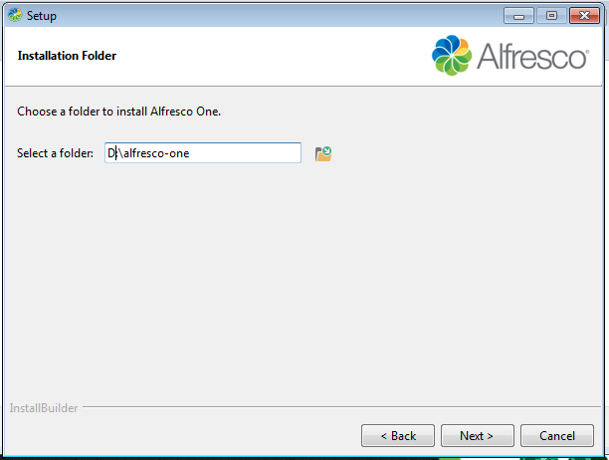
Alfresco Installation Steps
10

Slide 11
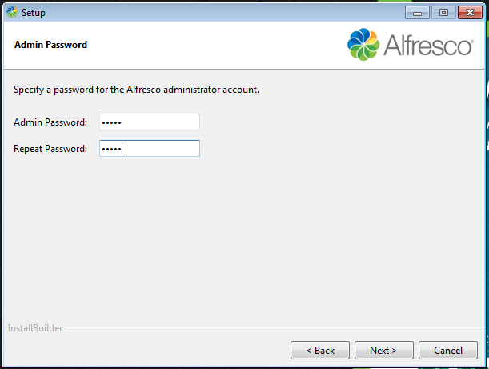
Alfresco Installation Steps
11

Slide 12
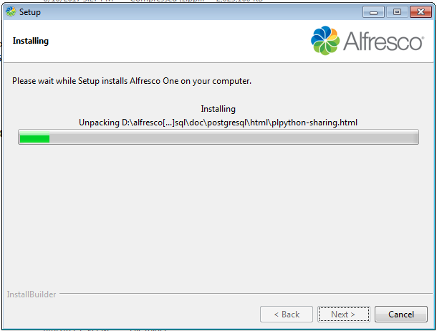
Alfresco Installation Steps
12

Slide 13
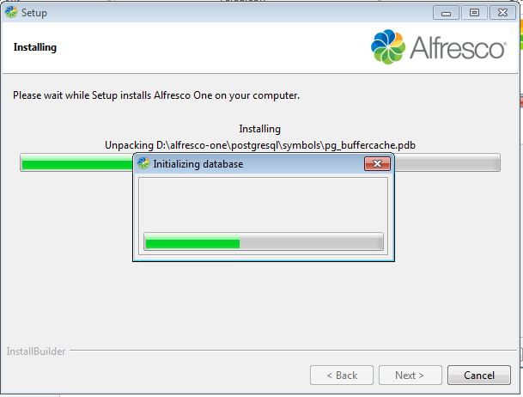
Alfresco Installation Steps
13

Slide 14
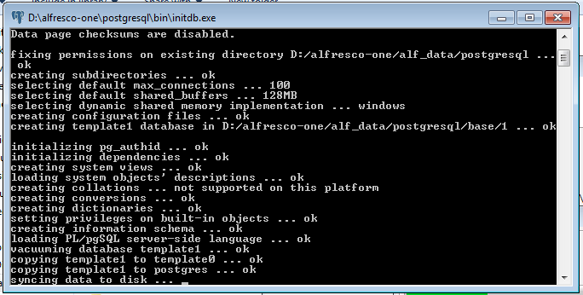
Alfresco Installation Steps
14

Slide 15
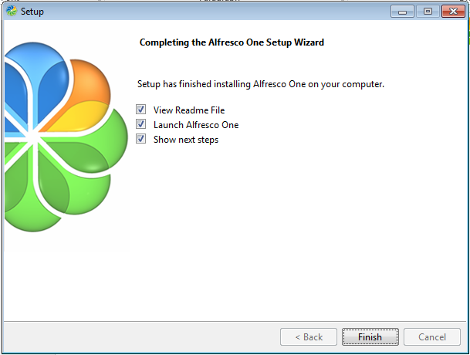
Alfresco Installation Steps
15

Slide 16
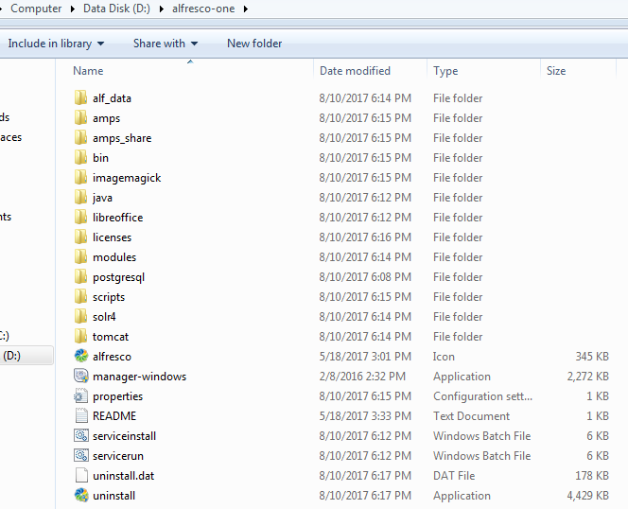
Alfresco Installation Steps
16

Slide 17
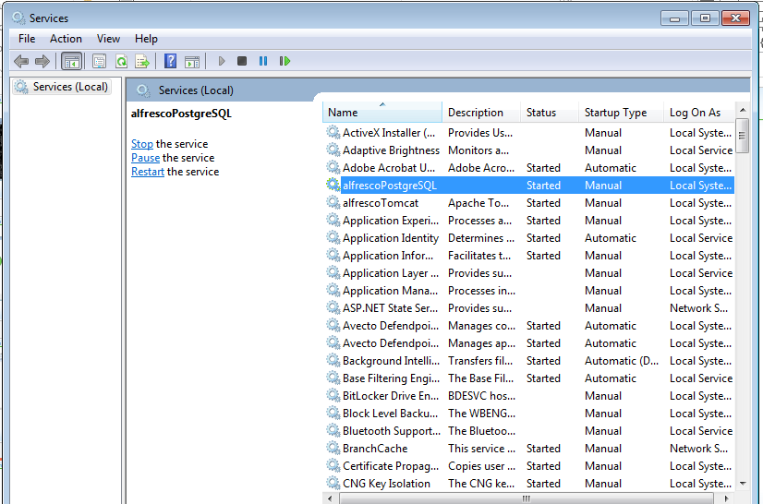
Starting and stopping Alfresco
17

Slide 18
Maven Overview
What is Maven?
Project management and comprehension tool.
Standardized build infrastructure.
Handles compilation, distribution, documentation, team collaboration and other tasks seamlessly.
Maven Philosophy
Convention over configuration
Ease the build process
Consistent build
Pre-requisite
Assuming JDK is installed in the system. To check Go to your command line and type the following command: javac –version
You will see a message such as the following, if you have the JDK installed: javac 1.8.0_112
18

Slide 19
Maven Overview
JDK Installation:
Login to OneCognizant app and go to OneIT.
Click 'Hardware & Software' >> Raise Hardware & Software Request
Search for JDK and click on the required JDK.
Raise the request.
Once the JDK is installed in system, configure the Environment variables.
Add the JAVA_HOME variable as :
JAVA_HOME = C:\Program Files\Java\jdk1.8.0_112
Append the JAVA_HOME variable in the Path variables, as :
Path = %JAVA_HOME%\bin;
To check Go to your command line and type the following command:
javac -version
19

Slide 20
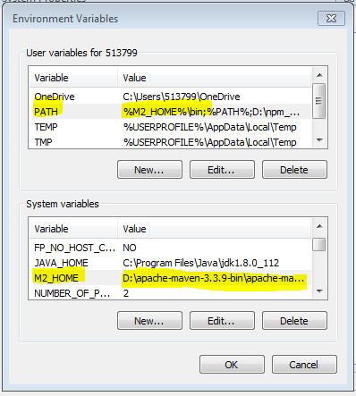
Maven Overview
Maven Configuration:
Download apache-maven-3.3.9-bin.zip from the below URL :
https://repo.maven.apache.org/maven2/org/apache/maven/apache-maven/3.3.9/
Place and extract the zip file in your system.
Configure the path in the Environment Variables as : M2_HOME = D:\apache-maven-3.3.9-bin\apache-maven-3.3.9 Append the M2_HOME in the PATH variable as, %M2_HOME%\bin;
20

Slide 21
Maven Overview
POM (pom.xml)
Maven project structure and contents are declared in an xml file, pom.xml referred as Project Object Model (POM).
Fundamental Unit of Work in Maven.
Resides in the base directory of the project.
Contains information about the project and various configuration detail used by Maven to build the project(s).
Contains the goals and plugins.
While executing a task or goal, Maven looks for the POM in the current directory. It reads the POM, gets the needed configuration information, then executes the goal.
Some of the configuration that can be specified in the POM are following:
Project dependencies
Plugins
Goals
Build profiles
Project version
Developers
Mailing list
21

Slide 22
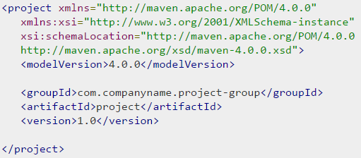
Maven Overview
Sample POM :
It should be noted that there should be a single POM file for each project.
All POM files require the project element and three mandatory fields: groupId, artifactId, version.
Projects notation in repository is groupId:artifactId:version.
22

Slide 23
Maven Overview
POM – major sub-nodes :
Node | Description
groupId | This is an Id of project's group. This is generally unique amongst an organization or a project. For example, a group com.cts.training has all training related projects.
artifactId | This is an Id of the project. This is generally name of the project. For example, maven-overview. Along with the groupId, the artifactId defines the artifact's location within the repository.
version | This is the version of the project. Along with the groupId, It is used within an artifact's repository to separate versions from each other. For example: com.cts.training:maven-overview:1.0 com.cts.training:maven-overview:1.1
23

Slide 24
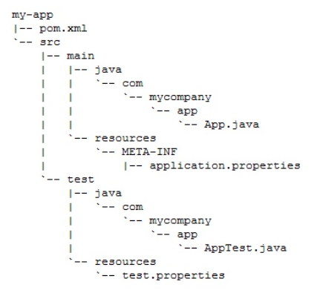
Maven Overview
Standard Directory Layout :
src/main/java
src/main/resources
src/test/java
src/test/resources
target
pom.xml
24

Slide 25
Maven Overview
Maven Build Lifecycle :
Phase | Description
validate | Validate the project is correct and all necessary information is available.
compile | Source code compilation is done in this phase.
test | Test the compiled source code using a suitable unit testing framework. These tests should not require the code be packaged or deployed
package | This phase creates the JAR / WAR package as mentioned in packaging in pom.xml.
verify | Run any checks on results of integration tests to ensure quality criteria are met
install | This phase installs the package in local / remote maven repository.
deploy | Done in the build environment, copies the final package to the remote repository for sharing with other developers and projects.
25

Slide 26
Alfresco SDK 3.0 overview
Alfresco SDK (Alfresco Software Development Kit) 3.0 is a Maven based development kit that provides an easy to use approach to developing applications and extensions for Alfresco.
Fundamental tool for customizations and extensions for Alfresco.
Based on Apache Maven.
Compatible with major IDEs.
Supports Alfresco Content Services both in Community Edition and Enterprise Edition.
All SDK 3.0 projects will produce a JAR
AMPs are still supported as an assembly, if you need to bring in 3rd party dependencies or override OOTB files.
SDK 3.0 is compatible with:
Alfresco One 4.2.x
Alfresco One 5.0.x
Alfresco One 5.1.x
Alfresco Content Services 5.2.x (and all the community releases)
26

Slide 27
Alfresco SDK 3.0 configuration
The SDK 3 comes with three project archetypes :
Archetype | Description
Alfresco All-In-One (AIO) | This is a multi-module project that leverages the Alfresco SDK's powerful capabilities to customize and run the full Alfresco platform embedded with all its components. The archetype does not require additional downloads and provides a perfect starting point for full-blown Alfresco projects.
Alfresco Repository archetype | This is used to create extensions for the Alfresco Repository Web Application (alfresco.war) in the form of Alfresco Module Packages (AMP).
Alfresco Share archetype | This is used to create extensions for the Alfresco Share Web Application (share.war) in the form of AMPs.
27

Slide 28
Create projects using Alfresco archetypes
Alfresco Repository AMP archetype :
This archetype generates a sample project for managing Alfresco Repository extensions/customizations.
These extensions are packaged as Alfresco Module Packages (AMP).
This archetype should be used to extend the Alfresco Repository web application (alfresco.war).
Creating a Repository Extension project (AMP) :
Run the following command : mvn archetype:generate -Dfilter=org.alfresco:
Choose the proper archetype : org.alfresco.maven.archetype:alfresco-amp-archetype
Choose the latest archetype version
You will be prompted to enter a value for “groupId” : Define value for property 'groupId': : com.cts
You will then be prompted to enter value for “artifactId” : Define value for property ‘artifactId': : componentX-repo
Enter a value for the “package” : Define value for property 'package': com.cts: : com.cts.componentX
Enter Y to accept the values. A new project directory “componentX-repo” has been created.
28

Slide 29
Create projects using Alfresco archetypes
Alfresco Share AMP archetype :
This archetype generates a sample project for managing Alfresco Share extensions/customizations.
These extensions are packaged as Alfresco Module Packages (AMP).
This archetype should be used to extend the Alfresco Share web application (share.war).
Creating a Share Extension project (AMP) :
Run the following command : mvn archetype:generate -Dfilter=org.alfresco:
Choose the proper archetype : org.alfresco.maven.archetype:share-amp-archetype
Choose the latest archetype version
You will be prompted to enter a value for “groupId” : Define value for property 'groupId': : com.cts
You will then be prompted to enter value for “artifactId” : Define value for property ‘artifactId': : componentX-share
Enter a value for the “package” : Define value for property 'package': com.cts: : com.cts.componentX
Enter Y to accept the values. A new project directory “componentX-share” has been created.
29

Slide 30
Create projects using Alfresco archetypes
Alfresco All-In-One (AIO) archetype :
This archetype is a multi-module project, leveraging Alfresco SDK's powerful capabilities to customize and run the full Alfresco platform embedded with all its components.
Final artifacts should be the customized alfresco.war and share.war.
Creating All-In-One project (AMP) :
Run the following command : mvn archetype:generate -DarchetypeGroupId=org.alfresco.maven.archetype -DarchetypeArtifactId=alfresco-allinone-archetype -DarchetypeVersion=3.0.0 -DinteractiveMode=false -DgroupId=com.cts -DartifactId=cts-extension-app
Once the package is generated, import the same in Eclipse, Mars or Neon3.0 and start building your customizations.
30

Slide 31
Packaging modules
Package | Description
Unpackaged files | Individual files, such as webscripts can be copied into the extension directory. This approach is not recommended for QA or production environments.
Zip file | Extensions can be packaged as zip files. This approach is not recommended for QA or production environments, as Tomcat (and other application servers) can re-explode WAR files at unpredictable times, thereby overwriting any extensions that have been deployed using this technique.
JAR file | Extensions can be packaged in standard JAR format and loaded by using the shared classpath. While it is possible to avoid the overwriting problem by placing these JAR files in tomcat/shared/lib (that is, outside of the web application directory structure itself), this is also not recommended for final deployment as this causes the JARs to be included on the classpath of every web application installed in that Tomcat server.
AMP file | This is the format of choice for most extensions, especially where the extension is to be widely distributed.
31

Slide 32
Alfresco Module Packages (AMPs)
This is the recommended way of packaging Alfresco customizations and extensions for deployment.
Advantages of using AMP files :
The minimum and maximum version of Alfresco Content Services required for the extension to operate correctly can be specified in the AMP file.
Dependencies on other modules can be declared in the AMP file.
AMP files can contain a module version number.
AMP file format :
The AMP file has a specific directory layout that contains the files that make up the extension. In addition it contains special files such as module-context.xml, module.properties and file-mapping.properties that control the behavior of the AMP.
32

Slide 33
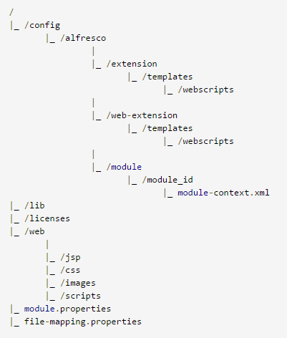
Alfresco Module Packages (AMPs)
AMP file structure :
The module package format is a compressed zip file. The AMP file has the following structure:
33

Slide 34
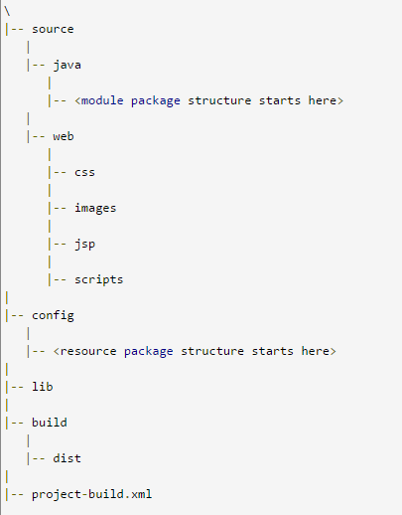
Alfresco Module Packages (AMPs)
Project Layout :
When developing a module it is recommended that code is structured in a consistent format to comply with AMP file requirements. The layout will be as follows :
34

Slide 35
References
Installing alfresco:
https://wiki.alfresco.com/wiki/Installing_on_Microsoft_Windows
Configuring database:
https://wiki.alfresco.com/wiki/Database_Configuration
Referred documents for Installation and administration:
http://docs.alfresco.com/5.2/concepts/ch-administering.html
Alfresco SDK 3.0:
http://docs.alfresco.com/5.2/concepts/sdk-intro.html
Alfresco SDK Archetypes:
http://docs.alfresco.com/sdk2.1/concepts/alfresco-sdk-archetypes.html
Creating Alfresco projects:
http://docs.alfresco.com/5.0/concepts/alfresco-sdk-tutorials-archetypes.html
AMP packaging:
http://docs.alfresco.com/5.2/concepts/dev-extensions-packaging-techniques-amps.html
35

Slide 36
Thank you

